Slide 1

A Study on European Start-Up Companies compared to Maltese Start-ups
Ismael Ben Daoud
Institute of Information & Communication Technology
MCAST, Paola, Malta

Slide 2
Problem Definition
Define different EU country start ups.
In order to have a good visual performance, power Bi was used to provide a well analytic report.
Maltese Start-up data is challenging to acquire, and minimum data supports it.
What is the problem I am undertaking?

Slide 3
Literature
Topic / Domain / Relevant theory
Power BI is known to be a free software to students provided by Microsoft to analyse data.
Start-up data is represented graphically using diagrams, charts, and maps.
Start-up visualization are made interactive so the user can customize how the data is displayed.
Power BI for start ups includes the function reporting, analysis, planning, forecast and dashboards.
Start-ups go through three fundamental stages: concept, launch, and growth, with each step representing distinct obstacles that can make or ruin a firm.

Slide 4
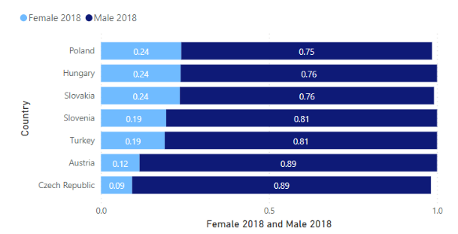
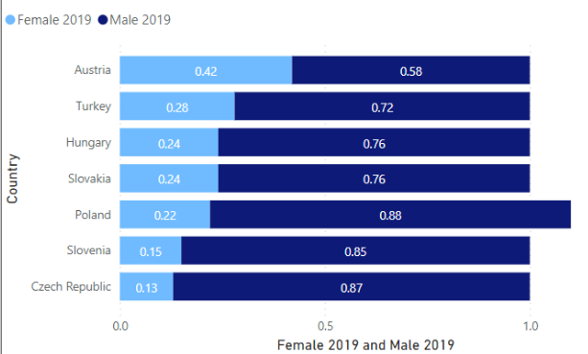
Literature
Sources / Data / Algorithms / Results
Two papers were used in order to compare 2018 data sets to 2019 data set;
EMS program a dataset based on EU start up countries
Analysing different gender distribution with power BI.
The data set of 2018 is taken from the paper which contained 21 countries.
The data set of 2019 is taken from the second paper which contained 32 countries.

Slide 5
Methodology – Aim, Hypothesis, Questions
The aim of this study is to gain a better understanding of other start-up businesses in various countries in Europe.
I want to identify the countries as similar to Malta in terms of ranking within statistics.
What is business intelligence and how can companies benefit from it?
Could start-ups find an interactive growth report useful with business intelligence?
What are the difficulties that a start-up faces?
What are the qualifications of a start-up founders in terms of their background?

Slide 6
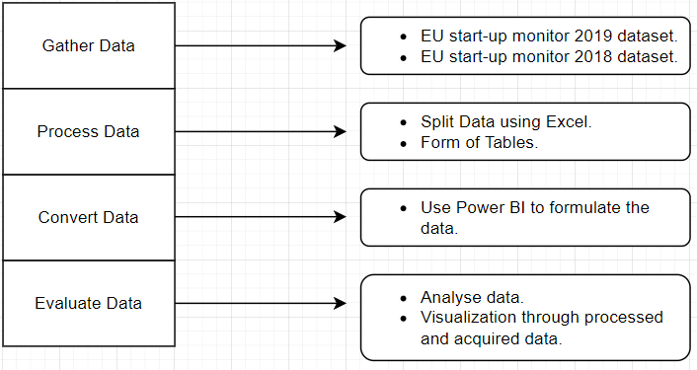
Methodology – Pipeline

Slide 7
Methodology – Methods
Power BI was used to create the nations involved and other pertinent information.
data was processed with Power BI and deployed according to the themes detected within the statistics.
a secondary quantitative method was adopted.
statistics from the European Start-up Monitor (ESM) was used.
Data was gathered from the major reports for 2018 and 2019.
Data contained from different countries;
Specific countries were chosen to be able to identify the changes within two years.
data was divided into the following categories: Demographics of the founders, stages of start-ups, motivation of start-ups, and level of education.

Slide 8
Data Evaluation
For gender distribution chart, Power BI framework was used in the form of Clustered chart.
The data for Types of education was created using Excel to calculate the average of each education than processed the data into Power BI in the form of a Pie Chart.
For the second figure, 2 stages and challenges of start ups were used to evaluate the challenges encounter and how they differ from each year, 2018 and 2019.
For the final phase, Types of Motivation was used to understand better the though behind starting a business using a dounat chart in power BI to calculate the average flow.

Slide 9
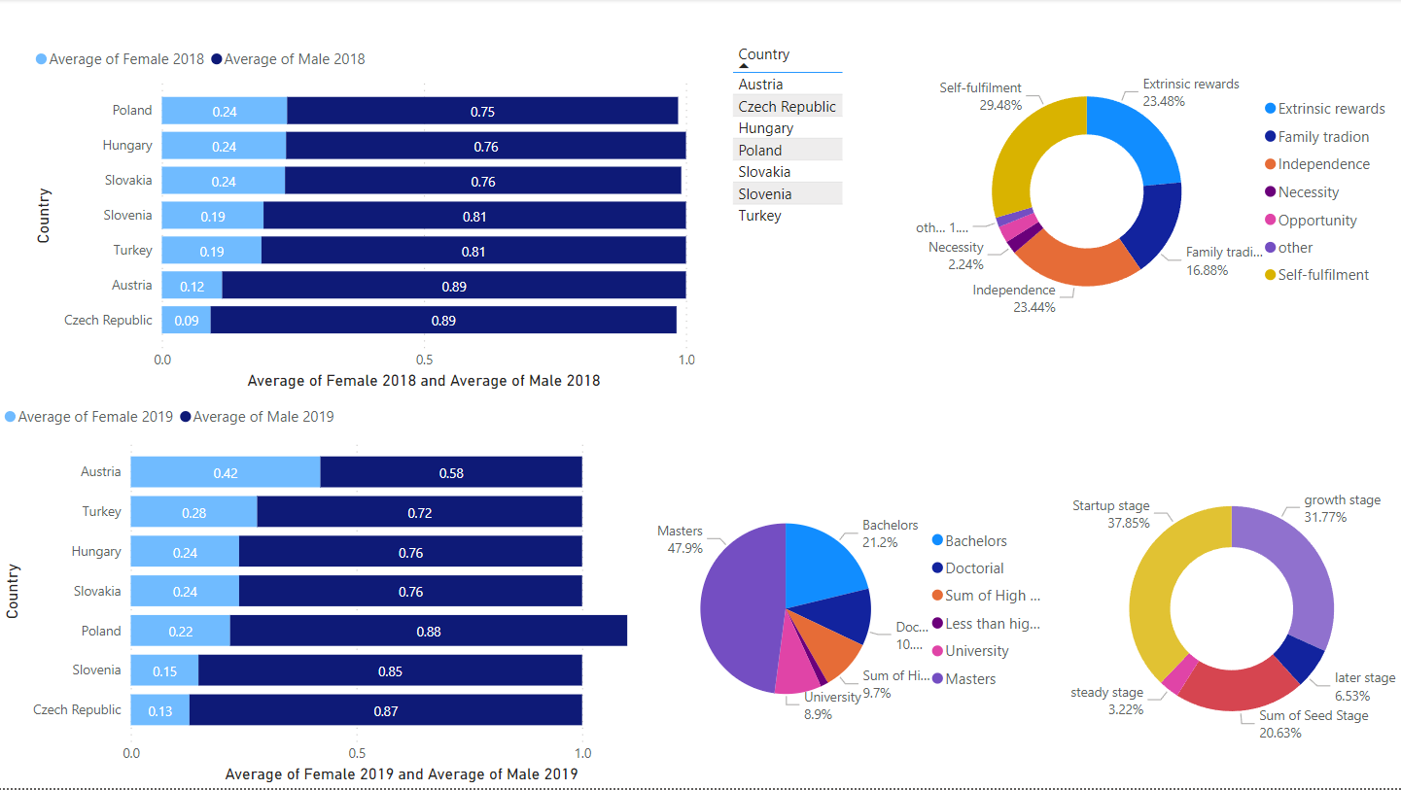
Prototype
Video Link: https://youtu.be/CpeeP6EIy94

Slide 10
Evaluation / Argumentation
Three evaluations are being made: Average percentage of male and female, Motivation of start up and Level of education.
The gender and level of education are combined together when it comes to evaluation the data.
Whilst motivation and stages are being analysed separately because they adapt to both results.
The most challenging task was averaging the 2019 gender distribution as the research I found it didn’t say the percentage. I had too manually do it myself.

Slide 11
Pipeline evaluation
This pipeline was created for the limited amount of time in a small scope as I need to consider other subjects.

Slide 12
Research Question evaluation
This project has been successful in terms of creating an interactive visualization.
It has been shown with Power BI that the majority of education background is Masters degree.
The most difficulties shown in the study were sale investment and competition.
Start ups have become more aware of the BI system and what it can lead to.
Start ups can benefit from Power BI thanks to the use of its tools by minizine risk, increase value and reduce cost.

Slide 13
Conclusions - Achievements
It has been observed that communal visualizations for start-ups in Europe are possible.
Potential start-ups may find this study beneficial.
Determining whether nations are performing well.
If they want to try to internationalize their business.

Slide 14
Conclusions - Recommendations
This research was constrained owing to a paucity of information about local start-ups.
Include more countries from the EU to the study.
in addition to not having access to all European nations.
Future research should incorporate more data from both different nations and from within the same country.
More study on local businesses is needed to see whether they would be interested in employing interactive visualization.

Slide 15
Conclusions - Limitations
There are not enough data when it comes to local data.
More study on local businesses is needed.
not having access to all European nations.
no primary research was conducted.
Future research should incorporate more data from different nations and from within the same country.

Slide 16
Future Recommendations
More study on local businesses is needed.
Take care of the lack of local study.
Contact local start-ups for a better understanding on local businesses.

Slide 17
References
Bormans, J., Bogen, E., Privitera, M. and Cooney, T., 2019. European Startup Monitor. [online] Europeanstartupmonitor2019.eu. Available at: <https://europeanstartupmonitor2019.eu/>.
Commission, E., 2019. 2019 SBA Fact Sheet & Scoreboard, Europe.
Commission, E., 2019. 2019 SBA Fact Sheet, MALTA.

Slide 18
References
Intetics. 2019. The Startup Lifecycle: How To Win At Each Stage - Intetics. [online] Available at: <https://intetics.com/blog/the-startup-lifecycle-how-to-win-at-each-stage/>.
Mauer, R. and Steigertahl, L., 2018. EU Startup Monitor. [online] Startupmonitor.eu. Available at: <http://startupmonitor.eu/>.

Slide 19
Thank you Ismael Ben Daoud

